Slide 1
Welcome!
Please, have a seat.
CWRU Quants
quants@case.edu
Notes:
Christo

Slide 2
Agenda
The Order Book
Importance to Quants
How to use it
Orderbook Data
Notes:
Christo

Slide 3
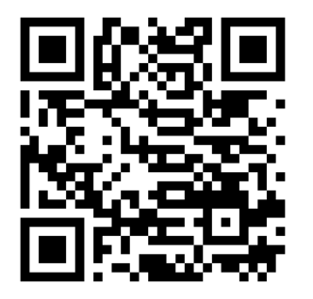
Attendance | CampusGroups
Notes:
Christo

Slide 4
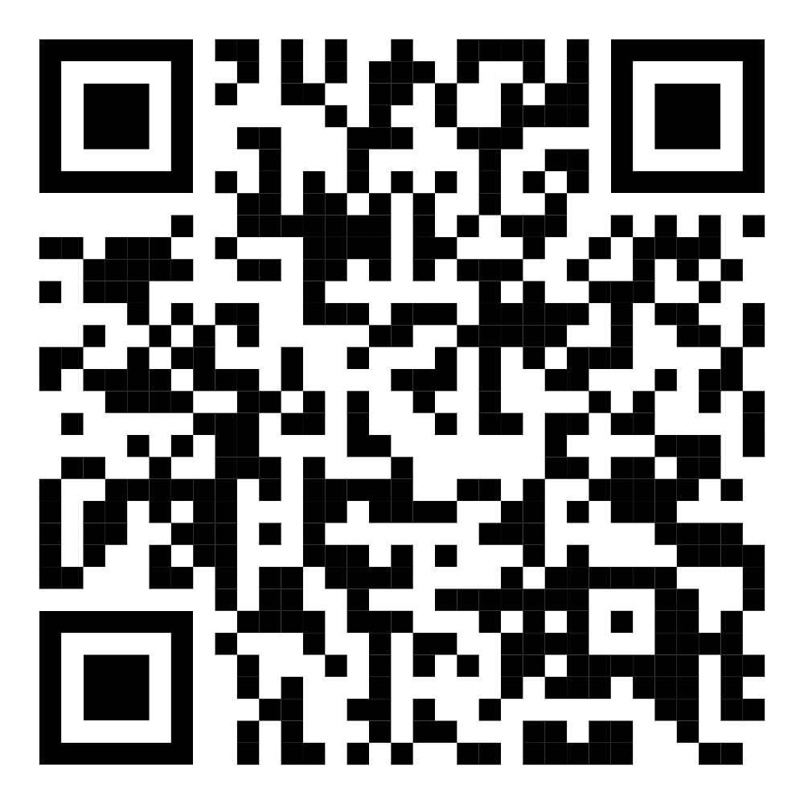
Discord (important!)
Notes:
Christo

Slide 5
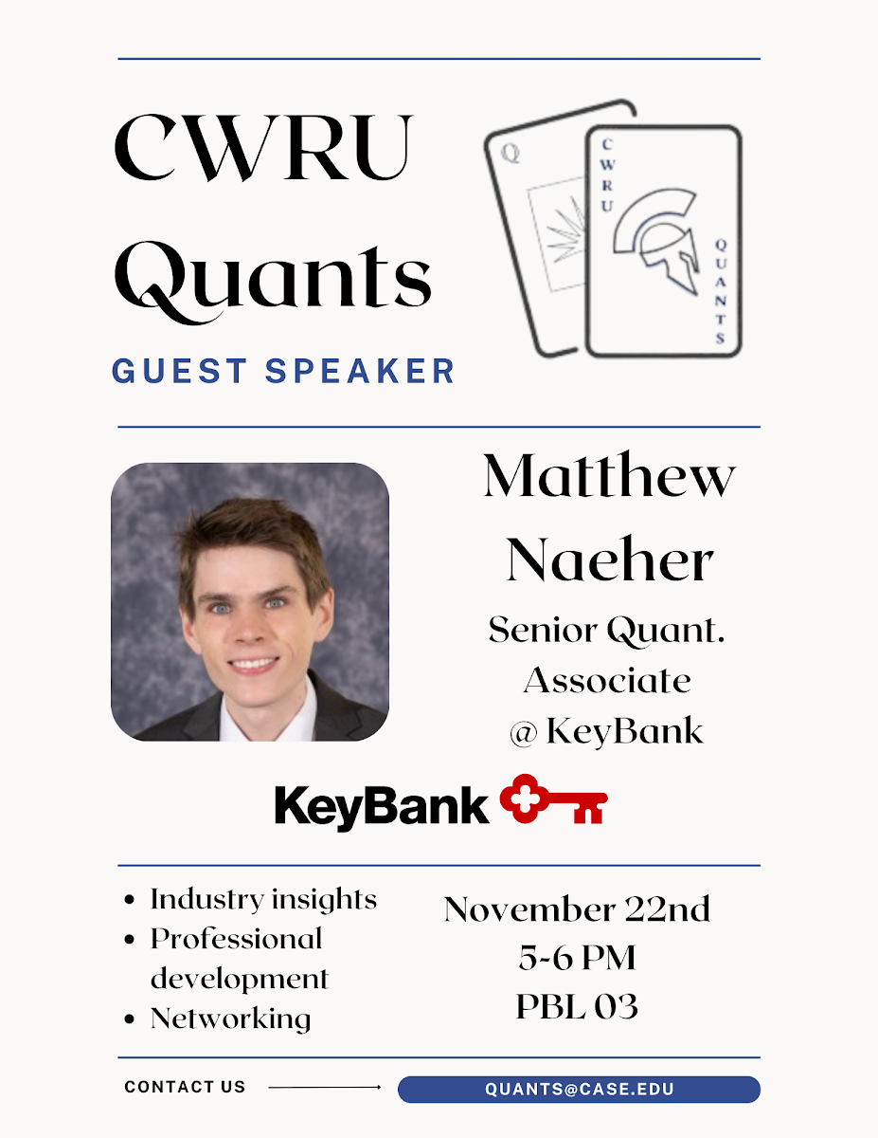
Next week…

Slide 6
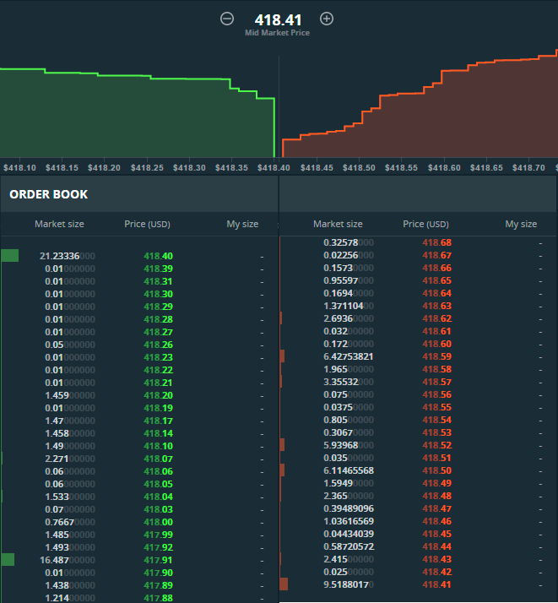
The Order Book
Notes:
Christo

Slide 7
What is an order book?
Where does it come from?
Bid-Ask Spread and Market Depth
An asset’s order book is a dynamic, real-time table of its active limit buy orders (bid) and sell orders (ask), each with its price.
Order books typically also contain the asset’s trade history.
When buyers want to buy an asset, they often want to buy only if they can get it for x dollars or below. Conversely, when sellers want to sell, they only want to sell for x dollars or above. An order book is simply a list of how many shares are waiting to be bought or sold at different price levels.
The bid-ask spread is the difference of the lowest ask and the highest bid.
Market depth refers to the number, size, and position of the orders behind the best bid and ask.
Notes:
Christo

Slide 8
An Important Note
Order books do not tell you about all transactions and orders on a security! Trades made in dark pools are completely hidden from all order books.
Dark pools are private security exchanges. They are typically used by large players who want to transact large amounts without notifying other market participants of their intentions.
For example, if an institutional investor is trying to sell its entire position of a stock, putting such a trade on public exchanges would alert the entire market of large selling pressure on the stock, causing the price to immediately drop.
Additionally, order books hide trades configured to only go through at the beginning or end of the trading day.
Notes:
Christo

Slide 9
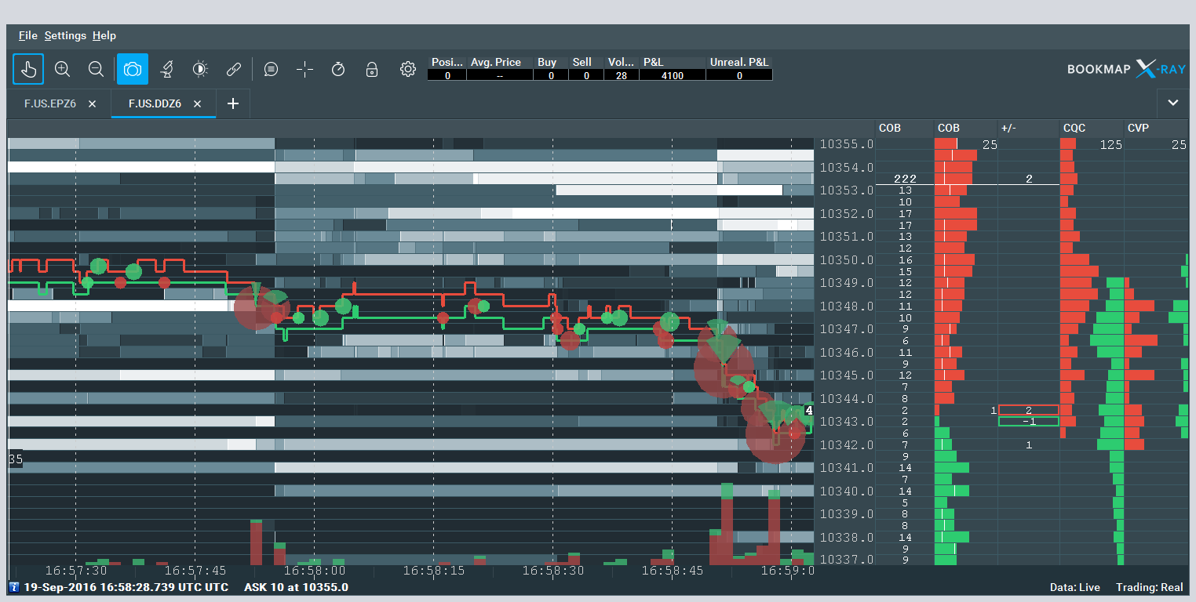
Importance to Quants
Notes:
Ray

Slide 10
What do orderbooks tell quants?
Liquidity - the ease of trading an asset. An orderbook with relatively few orders means that the asset is illiquid: trading it could take a long time and incur slippage costs.
This is very important to traders, as they’re responsible for getting a firm in or out of a position as efficiently as possible.
Spread - typically illiquid assets will also have a high bid-ask spread, indicating that slippage could be an issue in trading
Market making firms are able to sell at the ask (higher price) and buy at the bid (lower price). A wide bid-ask spread is an opportunity for a HFT market maker to quickly buy all the cheap shares and immediately sell them for a steep premium to profit until the bid rises and the ask falls. (think arbitrage!)
Quant developers who build backtesting software and simulations will often use orderbook data to find the spread and make trades fill at realistic prices
Notes:
https://www.pyquantnews.com/the-pyquant-newsletter/7-ways-to-use-order-book-data-to-improve-trading
Ray

Slide 11
What do orderbooks tell quants? (cont’d)
Impending Price Moves - A large imbalance towards one side of the book can be a sign that the side with more orders is about to push the price in their direction.
Researchers will develop new algorithms to detect order book imbalances and trade them – it isn’t as simple as just buy when there’s a buy imbalance and vice versa!
Arbitrage - Even if an asset has the same price on multiple exchanges, a significant difference in the order book on the exchanges could provide a signal for a future divergence in price
Developing algorithms around this is mostly the domain of researchers
Notes:
Ray

Slide 12
An Example: Optimal Trade Execution
Let’s say you’re a quant at a small fund that doesn’t have access to dark pools, and the firm would like to sell 100,000 shares of TSLA. You have been tasked with making the trade.
You know that if you try to buy it all at once, there will be slippage as the order book is “walked” (if you put it all at 330, you’ll fill all the available asks at 330, then all the available shares at 329, then 328, and so on until possibly 300 or lower!)
You also know that you can’t try to sell it too slowly, because that exposes you to market risk. What if Elon tweets something that causes a volatility event in the stock while you’re selling?!?
This leaves us with an optimization problem: how do we make the trade in a way that optimizes for minimal market impact and minimal execution time?
Notes:
Sid

Slide 13



Key Observations
You are trying to find the optimal trading speed, which we’ll call ν.
Once you start trading, the firm’s inventory of TSLA, denoted by Q, is a function of the trading speed. We can then define Q as seen at right.
Additionally, the bid and ask prices are also a function of your trading speed, since a higher speed will cause the order book to be walked faster. The mean of the bid and ask is denoted S and is defined as seen at right.
When selling the stock, you have to sell at some price between the bid and the ask, inclusive. Since you aren’t a market maker, you can’t just sell at the ask. Selling at the bid would be sub-optimal. Let the trading price be defined by the function at right.
Notes:
Sid

Slide 14


20 minutes of stochastic calculus and differential equations later, we arrive at…
Notes:
Sid

Slide 15

Our Result
It can be shown that the optimal selling speed is given by
If you’d like to see the derivation, source will be provided with slides
where P is the number of shares that need to be sold, T is the time after which you want all the shares to be gone, k is a parameter representing how much the order book walking rate will accelerate as you sell faster, and α is another parameter representing how much you prioritize ensuring that all shares are sold by the terminal time T.
This is very much a quant trading exercise, so if you’re interested in these types of problems, talk to Christo about the trading vertical!
Notes:
https://pdfroom.com/books/algorithmic-and-high-frequency-trading/NpgpZJMl5jr
Sid

Slide 16
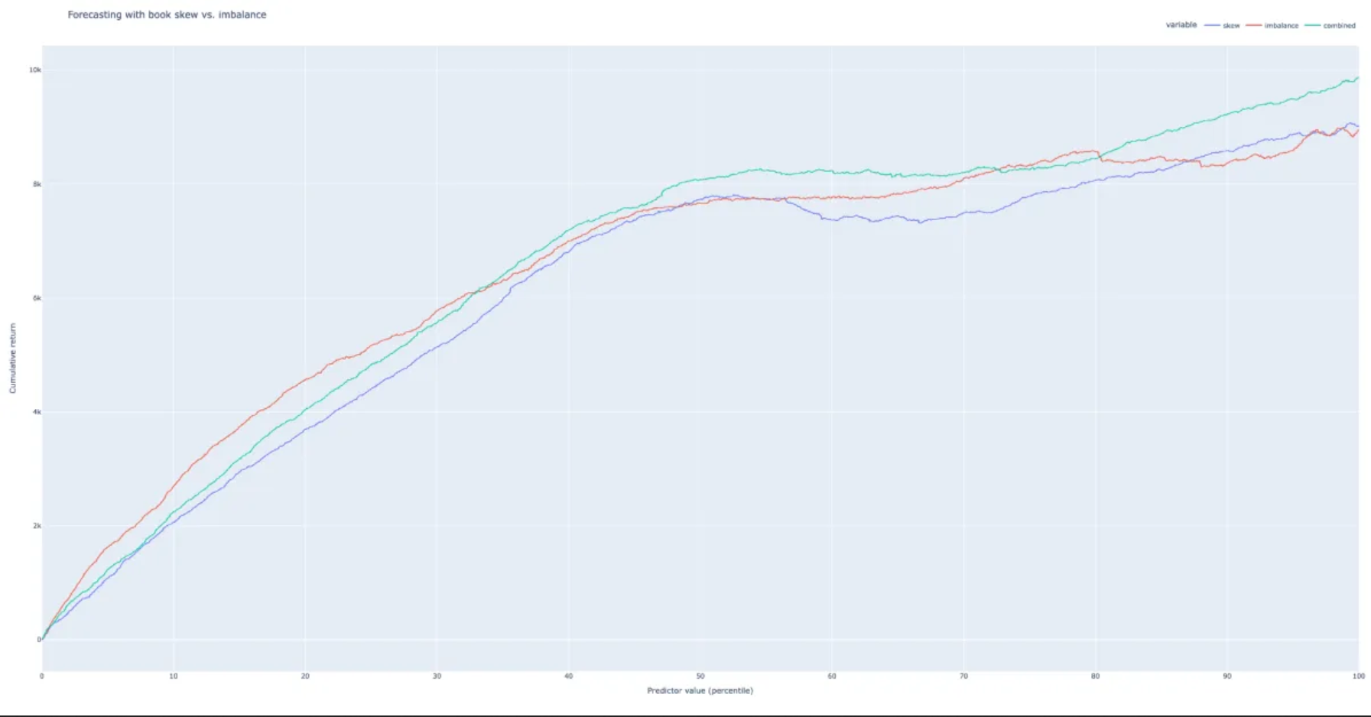
Using Order Book Data
Notes:
Ray

Slide 17
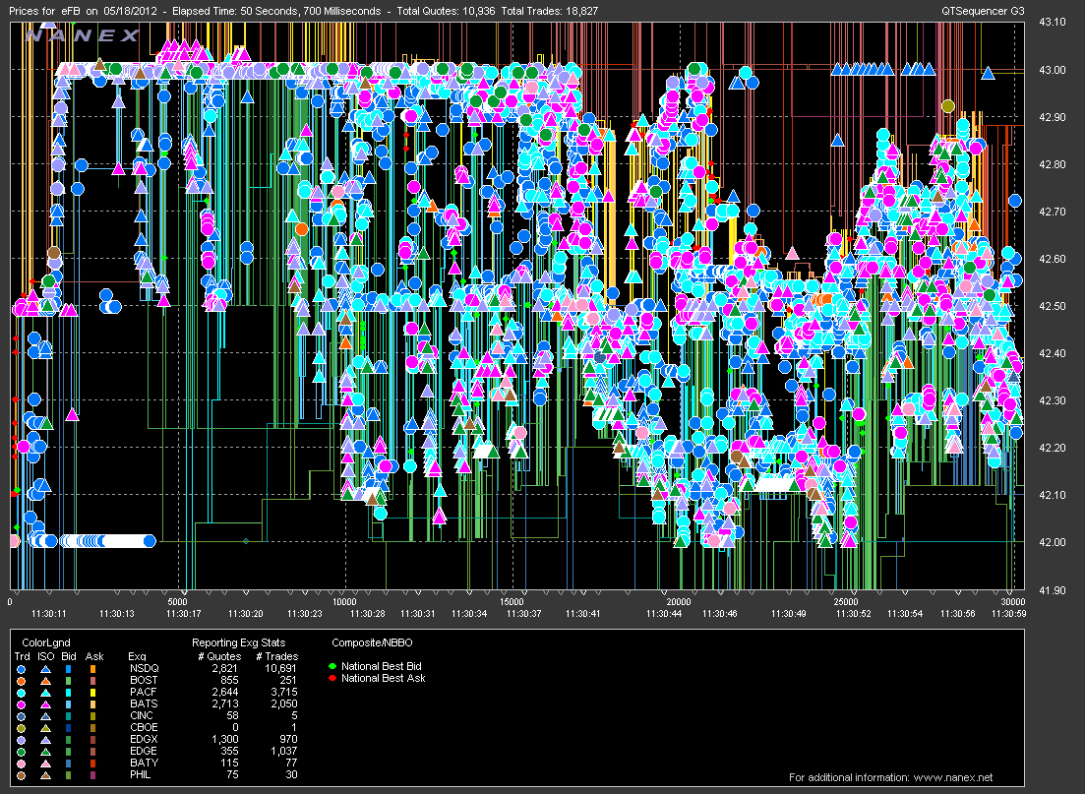
High-Frequency Trading Signals
Orderbook data sees extensive use in HFT as the data is real-time and updates quite rapidly
Order imbalance and skew have been researched extensively by publications and are used by firms to predict short-term price fluctuations
When you want to make predictions based on a massive quantity of data that changes frequently, the solution that comes to mind is…

Slide 18
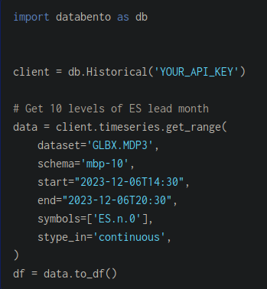
Machine Learning
Machine learning models can be trained on orderbook data to give trading signals. We’ll use S&P futures as an example, as they’re highly liquid and have a rich orderbook.
First collect the data…

Slide 19
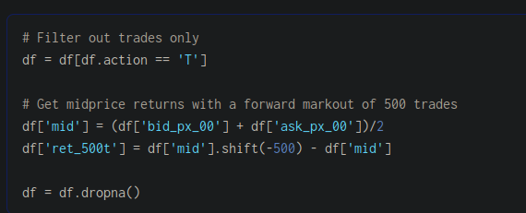
…then construct the prediction target (in this case, mid-price returns 500 trades out)...

Slide 20
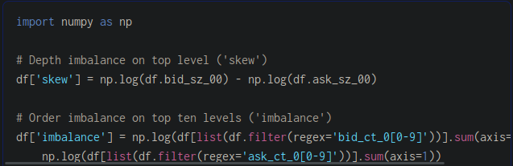

…and calculate our model inputs (order book skew and order imbalance).

Slide 21

Before training a model, it’s important to check the input parameters for collinearity with each other and correlation to the output.
As we can see, the inputs have moderate correlation against each other as measured by the Pearson coefficient. The correlation to the output might look low, but it is sufficient for this use case since order book data has a low signal-to-noise ratio.
Notes:
https://www.scribd.com/document/521690968/Barclays-US-Equity-Derivatives-Strategy-Impact-of-Retail-Options-Trading

Slide 22
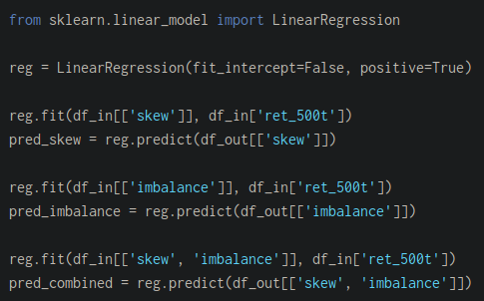
We can now train the model. A linear regression model is enough for this use case.

Slide 23
After training the model, we can use it to make predictions. The purple line is prediction based only on order book skew, the orange line is only order book imbalance, and the green line is both. The y-axis is cumulative returns, and we’re comparing the distribution of returns to the distribution of the predictors (we want a smoothly increasing curve). What we see is that there is value in both parameters and that they both have predictive power for returns.
This is very much a quant research exercise, so if this interests you, talk to Ethan about the research vertical!
Notes:
https://databento.com/blog/hft-sklearn-python

Slide 24
Obtaining Orderbook Data
Notes:
Ray

Slide 25
Some sources of data include…
Databento - https://databento.com/
LOBSTER - https://lobsterdata.com/
Crypto Lake - https://crypto-lake.com/

Slide 26
QUESTIONS AND ANSWERS
Contact us!
Email: quants@case.edu
Instagram: @cwruquants

